Slide 1
Advanced Automated Testing
With Selenium and appium

Slide 2
Agenda
Day 1
Introduction
Basics rules of automation
Design patterns
Implementation of automation project using Java and design patterns from scratch
Day 2
Introduction to mobile automation
Tools and frameworks
Appium
Integration of automation project and Appium server
Implementation and running of tests
Integration Appium with Selenium grid

Slide 3
Basics rules
It’s not possible to automate everything
Scope selection and time estimates are very important
It’s very problematic to test graphics design
Maintenance is not for free
More than 60% of failures are of type „automation issue“
Browsers and mobiles have different behavior
The biggest pain in automation are application changes and data
Without clean code and code patterns it's not almost possible to write and maintain the tests
Using of unique attributes to identify elements is VERY important
Using of relative path to find elements is VERY important
Tests must be parameterized as much as possible

Slide 4
Modification of applications
Every platform has unique attributes
Android: resource-id
iOS: accessibilityId
Is very important to use these attributes in automation or change the application code if they’re missing

Slide 5
Economy
Automated tests
Manual tests
Test design
Test execution

Slide 6
Economy
Automated tests
Manual tests
ROI
Test design
Test execution

Slide 7
Scope
Analysis of tested application
Analysis of tests to be automated
Analysis of test data
Analysis of tested devices
Browser types, browser versions, OS versions, device types…

Slide 8


Patterns
1-layer pattern
2-layered pattern
PageObjects
3-layered pattern
PageComponents
PageObjects

Slide 9
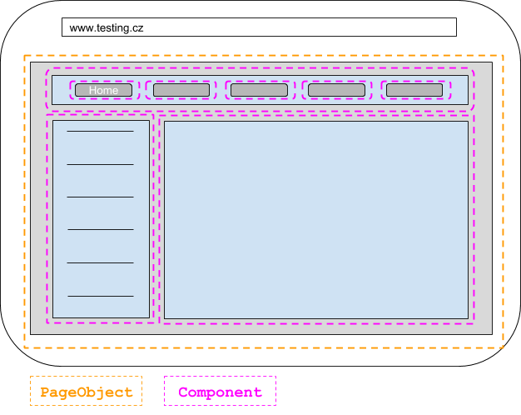
Patterns

